Slide 1
Week 3
Drawing: Vertex

Slide 2
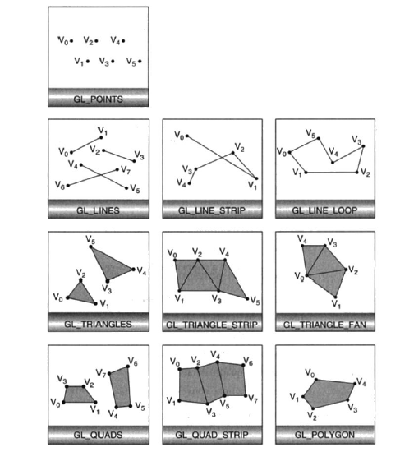

Slide 3
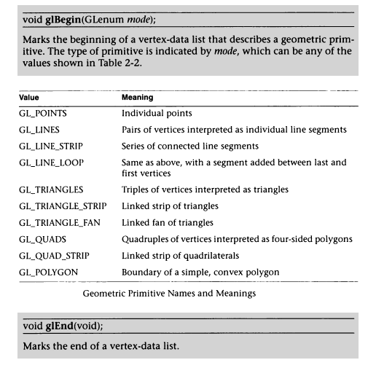

Slide 4
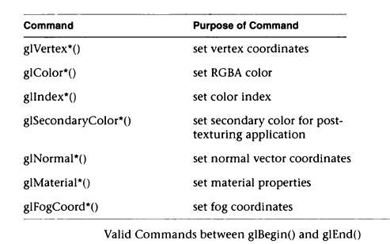

Slide 5
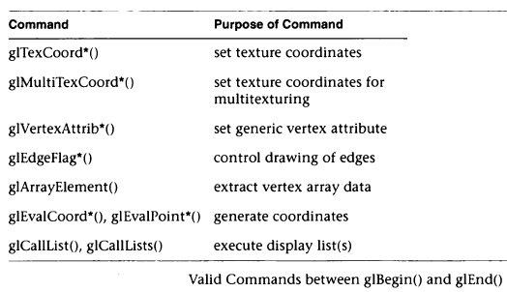

Slide 6
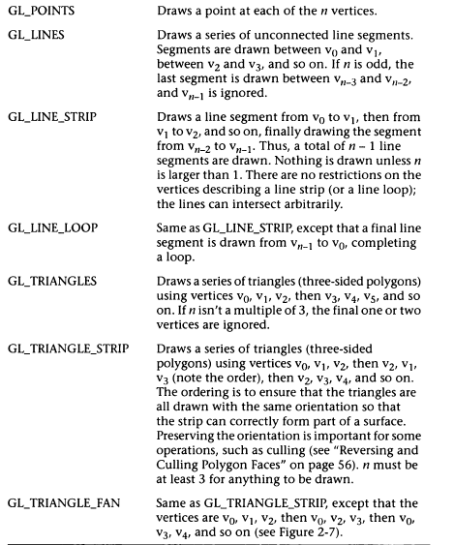

Slide 7
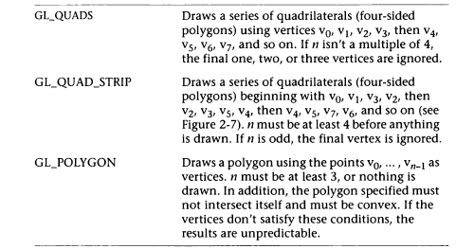

Slide 8
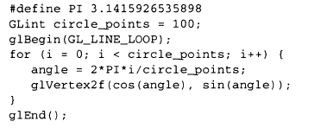
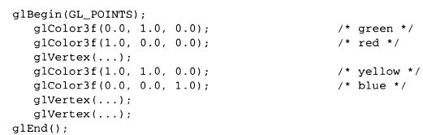

Slide 9
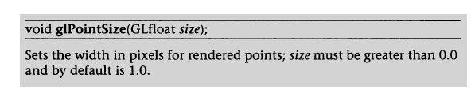
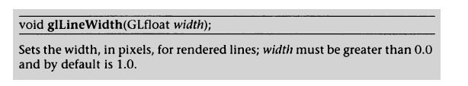
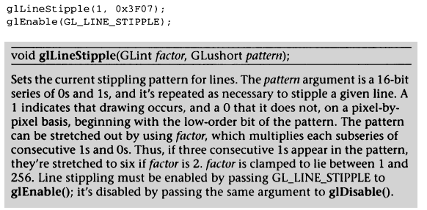

Slide 10

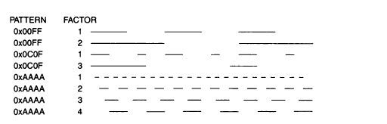

Slide 11


Slide 12
Simple Triangle:
#include <stdlib.h>
#include <glut.h>
void ayarlar(void){
glClearColor(1.0,1.0,1.0,1.0);
glShadeModel(GL_FLAT);
}
void ucgen(void){
glColor3f(0.0,1.0,1.0);
glBegin(GL_TRIANGLES);
glVertex2f(-0.4,-0.4);
glVertex2f(0.4,-0.4);
glVertex2f(0.0,0.4);
glEnd();
glDisable(GL_LINE_STIPPLE);
}

Slide 13
void koordinat(void){
glColor3f(0.0,0.0,1.0);
glBegin(GL_LINES);
glVertex2f(0.0,-1.0);
glVertex2f(0.0,1.0);
glVertex2f(1.0,0.0);
glVertex2f(-1.0,0.0);
glEnd();
}
void gosterim(void)
{
glClear(GL_COLOR_BUFFER_BIT);
ucgen();
koordinat();
glFlush();
}

Slide 14
int main(int argc,char ** argv)
{
glutInit(&argc,argv);
glutInitDisplayMode(GLUT_SINGLE | GLUT_RGB);
glutInitWindowPosition(0,0);
glutInitWindowSize(400,400);
glutCreateWindow("yeni");
ayarlar();
glutDisplayFunc(gosterim);
glutMainLoop();
return 0;
}

Slide 16
Lines:
#include <stdlib.h>
#include <glut.h>
void ayarlar(void){
glClearColor(0.0, 0.0, 0.0, 1.0);
glShadeModel(GL_FLAT); }
void gosterim(void){
glClear(GL_COLOR_BUFFER_BIT);
glColor3f(1.0, 1.0, 1.0);
glEnable(GL_LINE_STIPPLE);
glLineStipple(1, 0x0101);
glLineWidth(5);
glBegin(GL_LINES);
glVertex2f(50.0, 125.0);
glVertex2f(150.0, 125.0);
glEnd();
glDisable(GL_LINE_STIPPLE);
glFlush();}

Slide 17
void reshape(int w, int h){
glViewport(0, 0, (GLsizei)w, (GLsizei)h);
glMatrixMode(GL_PROJECTION);
glLoadIdentity();
gluOrtho2D(0.0, (GLdouble)w, 0.0, (GLdouble)h);
}
int main(int argc, char ** argv){
glutInit(&argc, argv);
glutInitDisplayMode(GLUT_SINGLE | GLUT_RGB);
glutInitWindowSize(400, 150);
glutInitWindowPosition(100, 100);
glutCreateWindow(argv[0]);
ayarlar();
glutDisplayFunc(gosterim);
glutReshapeFunc(reshape);
glutMainLoop();
return 0;
}

Slide 19
#include <stdlib.h> ////Kesikli çizgilere örnek 2
#include <glut.h>
#define drawOneLine(x1,y1,x2,y2) glBegin(GL_LINES); \
glVertex2f ((x1),(y1)); glVertex2f ((x2),(y2)); glEnd();
void init(void)
{
glClearColor (0.0, 0.0, 0.0, 0.0);
glShadeModel (GL_FLAT);
}
void display(void)
{
int i;
glClear (GL_COLOR_BUFFER_BIT);
/* select white for all lines */
glColor3f (1.0, 1.0, 1.0);
/* in 1st row, 3 lines, each with a different stipple */
glEnable (GL_LINE_STIPPLE);
glLineStipple (1, 0x0101); /* dotted */
drawOneLine (50.0, 125.0, 150.0, 125.0);
glLineStipple (1, 0x00FF); /* dashed */
drawOneLine (150.0, 125.0, 250.0, 125.0);
glLineStipple (1, 0x1C47); /* dash/dot/dash */
drawOneLine (250.0, 125.0, 350.0, 125.0);

Slide 20
glLineWidth (5.0);
glLineStipple (1, 0x0101); /* dotted */
drawOneLine (50.0, 100.0, 150.0, 100.0);
glLineStipple (1, 0x00FF); /* dashed */
drawOneLine (150.0, 100.0, 250.0, 100.0);
glLineStipple (1, 0x1C47); /* dash/dot/dash */
drawOneLine (250.0, 100.0, 350.0, 100.0);
glLineWidth (1.0);
/* in 3rd row, 6 lines, with dash/dot/dash stipple as part of a single connected line strip */
glLineStipple (1, 0x1C47); /* dash/dot/dash */
glBegin (GL_LINE_STRIP);
for (i = 0; i < 7; i++)
glVertex2f (50.0 + ((GLfloat) i * 50.0), 75.0);
glEnd ();
/* in 4th row, 6 independent lines with same stipple */
for (i = 0; i < 6; i++) {
drawOneLine (50.0 + ((GLfloat) i * 50.0), 50.0,
50.0 + ((GLfloat)(i+1) * 50.0), 50.0);
}
/* in 5th row, 1 line, with dash/dot/dash stipple and a stipple repeat factor of 5 */
glLineStipple (5, 0x1C47); /* dash/dot/dash */
drawOneLine (50.0, 25.0, 350.0, 25.0);
glDisable (GL_LINE_STIPPLE);
glFlush ();
}
void reshape (int w, int h)
{
glViewport (0, 0, (GLsizei) w, (GLsizei) h);
glMatrixMode (GL_PROJECTION);
glLoadIdentity ();
gluOrtho2D (0.0, (GLdouble) w, 0.0, (GLdouble) h);
}
int main(int argc, char** argv)
{
glutInit(&argc, argv); glutInitDisplayMode (GLUT_SINGLE | GLUT_RGB);
glutInitWindowSize (400, 150); glutInitWindowPosition (100, 100);
glutCreateWindow (argv[0]); init ();
glutDisplayFunc(display); glutReshapeFunc(reshape);
glutMainLoop(); return 0; }

Slide 22
#include <stdlib.h> //Kesikli çizgi ve kordinat sistemi
#include <glut.h>
void ayarlar(void)
{
glClearColor(1.0,1.0,1.0,1.0);
glShadeModel(GL_FLAT);
}
void kesikcizgi(void)
{
glColor3f(0.0,0.0,1.0);
glEnable(GL_LINE_STIPPLE);
glLineStipple(1 , 0xff);
glBegin(GL_LINES);
glVertex2f(0.5,0.4);
glVertex2f(-0.5,0.4);
glEnd();
glDisable(GL_LINE_STIPPLE);
}

Slide 23
void koordinat(void)
{
glColor3f(0.0,0.0,1.0);
glBegin(GL_LINES);
glVertex2f(0.0,-1.0);
glVertex2f(0.0,1.0);
glVertex2f(1.0,0.0);
glVertex2f(-1.0,0.0);
glEnd();
}

Slide 24
void gosterim(void){
glClear(GL_COLOR_BUFFER_BIT);
koordinat();
kesikcizgi();
glFlush();
}
int main(int argc,char ** argv) {
glutInit(&argc,argv);
glutInitDisplayMode(GLUT_SINGLE | GLUT_RGB);
glutInitWindowPosition(0,0);
glutInitWindowSize(400,400);
glutCreateWindow("koordinat kesik çizgi");
ayarlar();
glutDisplayFunc(gosterim);
glutMainLoop();
return 0; }

Slide 26
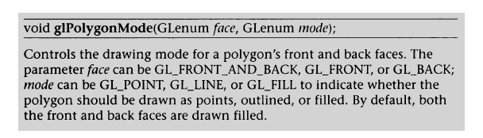

Polygons

Slide 27
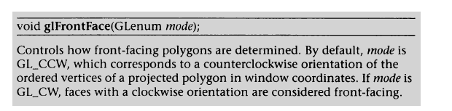
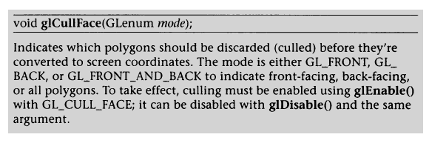

Slide 28
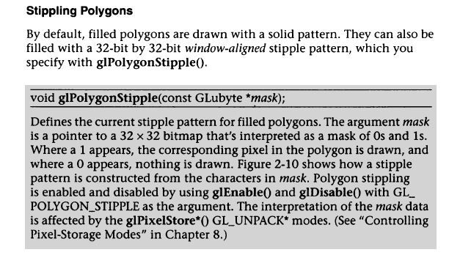

Slide 30
Smooth polygon
#include <stdlib.h>
#include <glut.h>
void init(void){
glClearColor(0.0, 0.0, 0.0, 0.0);
glShadeModel(GL_SMOOTH);
}
void triangle(void){
glBegin(GL_TRIANGLES);
glColor3f(1.0, 0.0, 0.0);
glVertex2f(5.0, 5.0);
glColor3f(0.0, 1.0, 0.0);
glVertex2f(25.0, 5.0);
glColor3f(0.0, 0.0, 1.0);
glVertex2f(5.0, 25.0);
glEnd();
}

Slide 31
void display(void){
glClear(GL_COLOR_BUFFER_BIT);
triangle();
glFlush();
}
void reshape(int w, int h){
glViewport(0, 0, (GLsizei)w, (GLsizei)h);
glMatrixMode(GL_PROJECTION);
glLoadIdentity();
if (w <= h)
gluOrtho2D(0.0, 30.0, 0.0, 30.0 * (GLfloat)h / (GLfloat)w);
else
gluOrtho2D(0.0, 30.0 * (GLfloat)w / (GLfloat)h, 0.0, 30.0);
glMatrixMode(GL_MODELVIEW);
}

Slide 32
int main(int argc, char** argv)
{
glutInit(&argc, argv);
glutInitDisplayMode(GLUT_SINGLE | GLUT_RGB);
glutInitWindowSize(500, 500);
glutInitWindowPosition(100, 100);
glutCreateWindow(argv[0]);
init();
glutDisplayFunc(display);
glutReshapeFunc(reshape);
glutMainLoop();
return 0;
}

Slide 34
Klavye Kullanımı
void keyboard (unsigned char key, int x, int y){
switch (key)
{
case ‘d':
day = (day + 10) % 360;
glutPostRedisplay(); break;
Case ‘D':
day = (day - 10) % 360;
glutPostRedisplay(); break;
default:
break;
}

Slide 35
Reshape:
void reshape (int w, int h)
{
glViewport (0, 0, (GLsizei) w, (GLsizei) h);
glMatrixMode (GL_PROJECTION);
glLoadIdentity ();
gluPerspective(60.0, (GLfloat) w/(GLfloat) h, 1.0, 20.0);
glMatrixMode(GL_MODELVIEW);
glLoadIdentity();
gluLookAt (0.0, 0.0, 5.0, 0.0, 0.0, 0.0, 0.0, 1.0, 0.0);
}

Slide 37
#include <stdlib.h>
#include <glut.h>
float a=0;
void ayarlar(void)
{
glClearColor(1.0,1.0,1.0,1.0);
glShadeModel(GL_FLAT);
}
void hesapla(void)
{
a=a+0.5;
glutPostRedisplay();
}

Slide 38
void tekrarboyut(int en , int boy)
{
glViewport(0,0,(GLsizei)en,(GLsizei)boy);
glMatrixMode(GL_PROJECTION);
glLoadIdentity();
if(en<=boy)
gluOrtho2D(-2.0,2.0,-2.0*(float)boy/(float)en,2.0*(float)boy/(float)en);
else
gluOrtho2D(-2.0*(float)en/(float)boy,2.0*(float)en/(float)boy,-2.0,2.0);
glMatrixMode(GL_MODELVIEW);
glLoadIdentity();
}

Slide 39
void ucgen(void)
{
glColor3f(0.0,1.0,1.0);
glRotatef(a,0.0,0.0,-1.0);
glBegin(GL_TRIANGLES);
glVertex2f(-1.2,-1.2);
glVertex2f(1.2,-1.2);
glVertex2f(0.0,1.2);
glEnd();
}
void gosterim(void)
{
glClear(GL_COLOR_BUFFER_BIT);
glLoadIdentity();
ucgen();
hesapla();
glutSwapBuffers();
}

Slide 40
int main(int argc,char ** argv)
{
glutInit(&argc,argv);
glutInitDisplayMode(GLUT_DOUBLE | GLUT_RGB);
glutInitWindowPosition(0,0);
glutInitWindowSize(400,400);
glutCreateWindow("gösterim2");
ayarlar();
glutReshapeFunc(tekrarboyut);
glutDisplayFunc(gosterim);
glutMainLoop();
return 0;
}

Slide 42
#include <stdlib.h>
#include<math.h>
#include <glut.h>
void ayarlar(void)
{
glClearColor(1.0,1.0,1.0,1.0);
glShadeModel(GL_FLAT);
glPolygonMode(GL_FRONT,GL_FILL);
}

Slide 43
void gosterim(void)
{ double der=0;
int a=0;
glClear(GL_COLOR_BUFFER_BIT);
glColor3f(0.0,0.0,1.0);
glBegin(GL_POLYGON);
for(a=0;a<360;a++)
{
der=2*3.14*a/360;
glVertex2f(cos(der)*0.5 , sin(der)*0.5);
}
glEnd();
glFlush();
}

Slide 44
int main(int argc,char ** argv)
{
glutInit(&argc,argv);
glutInitDisplayMode(GLUT_SINGLE | GLUT_RGB);
glutInitWindowPosition(0,0);
glutInitWindowSize(400,400);
glutCreateWindow("çember");
ayarlar();
glutDisplayFunc(gosterim);
glutMainLoop();
return 0;
}

Slide 46
Mouse Kullanımı
void mouse(int button, int state, int x, int y){
switch (button) {
case GLUT_LEFT_BUTTON:
if (state == GLUT_DOWN) {
spin = (spin + 30) % 360;
glutPostRedisplay();
} break;
default: break;
}
}

Slide 48
#include <stdlib.h>
#include <glut.h>
int spin = 0.0;
void ayarlar(void)
{
glClearColor(1.0, 1.0, 1.0, 1.0);
glShadeModel(GL_FLAT);
}
void ucgen(void)
{
glPolygonMode(GL_FRONT, GL_FILL);
glRotatef(spin, 1.0, 0.0, 0.0);
glColor3f(0.0, 1.0, 1.0);
glBegin(GL_TRIANGLES);
glVertex2f(-0.4, -0.4);
glVertex2f(0.4, -0.4);
glVertex2f(0.0, 0.4);
glEnd();
}

Slide 49
void mouse(int button, int state, int x, int y)
{
switch (button) {
case GLUT_LEFT_BUTTON:
if (state == GLUT_DOWN){
spin = (spin + 30) % 360;
glutPostRedisplay();
} break;
case GLUT_MIDDLE_BUTTON:
case GLUT_RIGHT_BUTTON:
if (state == GLUT_DOWN){
spin = (spin - 30) % 360;
glutPostRedisplay();
}break;
default:break;
}
}

Slide 50
void koordinat(void)
{
glColor3f(0.0, 0.0, 1.0);
glBegin(GL_LINES);
glVertex2f(0.0, -1.0);
glVertex2f(0.0, 1.0);
glVertex2f(1.0, 0.0);
glVertex2f(-1.0, 0.0);
glEnd();
}
void gosterim(void)
{
glClear(GL_COLOR_BUFFER_BIT);
glLoadIdentity();
koordinat();
ucgen();
glFlush();
}

Slide 51
void reshape(int w, int h){
glViewport(0, 0, (GLsizei)w, (GLsizei)h);
glMatrixMode(GL_PROJECTION);
glLoadIdentity();
glOrtho(-1.0, 1.0, -1.0, 1.0, -1.0, 1.0);
glMatrixMode(GL_MODELVIEW);
glLoadIdentity();
}
int main(int argc, char ** argv){
glutInit(&argc, argv);
glutInitDisplayMode (GLUT_DOUBLE | GLUT_RGB);
glutInitDisplayMode(GLUT_SINGLE | GLUT_RGB);
glutInitWindowPosition(50, 50);
glutInitWindowSize(200, 200);
glutCreateWindow("üçgen");
ayarlar();
glutDisplayFunc(gosterim);
glutReshapeFunc(reshape);
glutMouseFunc(mouse);
glutMainLoop();
return 0; }

Slide 53
#include <stdlib.h>
#include <glut.h>
float a = 0;
void ayarlar(void){
glClearColor(1.0, 1.0, 1.0, 1.0);
glShadeModel(GL_FLAT);
}
void hesapla(void){
a = a + 0.1;
glutPostRedisplay();
}
void ucgen(void) {
glColor3f(0.0, 1.0, 1.0);
glRotatef(a, 0.0, 0.0, -1.0);
glBegin(GL_TRIANGLES);
glVertex2f(-0.2, -0.2);
glVertex2f(0.2, -0.2);
glVertex2f(0.0, 0.2);
glEnd();
}

Slide 54
void gosterim(void){
glClear(GL_COLOR_BUFFER_BIT);
glLoadIdentity();
glViewport(0, 0, 400, 400);
ucgen(); hesapla(); glLoadIdentity();
glViewport(200, 200, 200, 200);
ucgen(); hesapla(); glLoadIdentity();
glViewport(0, 200, 200, 200);
ucgen(); hesapla(); glLoadIdentity();
glViewport(0, 0, 200, 200);
ucgen(); hesapla(); glLoadIdentity();
glViewport(200, 0, 200, 200);
ucgen(); hesapla();
glutSwapBuffers();
}

Slide 55
int main(int argc, char ** argv)
{
glutInit(&argc, argv);
glutInitDisplayMode(GLUT_DOUBLE | GLUT_RGB);
glutInitWindowPosition(0, 0);
glutInitWindowSize(400, 400);
glutCreateWindow("görüntü çıktısı");
ayarlar();
glutDisplayFunc(gosterim);
glutMainLoop();
return 0;
}

Slide 57
polygon
#include <stdlib.h>
#include <glut.h>
Void myinit(void) {
GLfloat light_ambient[] =
{ 0.0, 0.0, 0.0, 1.0 };
GLfloat light_diffuse[] =
{ 1.0, 0.0, 0.0, 1.0 };
GLfloat light_specular[] =
{ 1.0, 1.0, 1.0, 1.0 };
GLfloat light_position[] =/* light_position is NOT default value */
{ 1.0, 1.0, 1.0, 0.0 };

Slide 58
glLightfv(GL_LIGHT0, GL_AMBIENT, light_ambient);
glLightfv(GL_LIGHT0, GL_DIFFUSE, light_diffuse);
glLightfv(GL_LIGHT0, GL_SPECULAR, light_specular);
glLightfv(GL_LIGHT0, GL_POSITION, light_position);
glEnable(GL_LIGHT0);
glDepthFunc(GL_LESS);
glEnable(GL_DEPTH_TEST);
glEnable(GL_LIGHTING);
}

Slide 59
Void display(void)
{
glClear(GL_COLOR_BUFFER_BIT | GL_DEPTH_BUFFER_BIT);
glPushMatrix();
glScalef(1.3, 1.3, 1.3);
glRotatef(20.0, 1.0, 0.0, 0.0);
glPushMatrix();
glTranslatef(-0.75, 0.5, 0.0);
glRotatef(90.0, 1.0, 0.0, 0.0);
glutSolidTorus(0.275, 0.85, 10, 15);
glPopMatrix();

Slide 60
glPushMatrix();
glTranslatef(-0.75, -0.5, 0.0);
glRotatef(270.0, 1.0, 0.0, 0.0);
glutSolidTetrahedron();
glPopMatrix();
glPushMatrix();
glTranslatef(0.75, 0.0, -1.0);
glutSolidIcosahedron();
glPopMatrix();
glPopMatrix();
glFlush();
}

Slide 61
void myReshape(int w, int h)
{
glViewport(0, 0, w, h);
glMatrixMode(GL_PROJECTION);
glLoadIdentity();
if (w <= h)
glOrtho(-2.5, 2.5, -2.5 * (GLfloat)h / (GLfloat)w,
2.5 * (GLfloat)h / (GLfloat)w, -10.0, 10.0);
else
glOrtho(-2.5 * (GLfloat)w / (GLfloat)h,
2.5 * (GLfloat)w / (GLfloat)h, -2.5, 2.5, -10.0, 10.0);
glMatrixMode(GL_MODELVIEW);
}

Slide 62
polygon_mode(int value) {
switch (value) {
case 1:
glEnable(GL_DEPTH_TEST); glEnable(GL_LIGHTING);
glDisable(GL_BLEND);
glPolygonMode(GL_FRONT_AND_BACK, GL_FILL);
break;
case 2:
glDisable(GL_DEPTH_TEST); glDisable(GL_LIGHTING);
glColor3f(1.0, 1.0, 1.0);
glPolygonMode(GL_FRONT_AND_BACK, GL_LINE);
glEnable(GL_LINE_SMOOTH); glEnable(GL_BLEND);
glBlendFunc(GL_SRC_ALPHA, GL_ONE_MINUS_SRC_ALPHA);
break;
}
glutPostRedisplay(); }

Slide 63
void main_menu(int value)
{
if (value == 666)
exit(0);
}

Slide 64
int main(int argc, char **argv) {
int submenu;
glutInit(&argc, argv);
glutInitWindowPosition(500, 500);
glutInitWindowSize(500, 500);
glutCreateWindow(argv[0]);
myinit();
glutReshapeFunc(myReshape);
glutDisplayFunc(display);
submenu = glutCreateMenu(polygon_mode);
glutAddMenuEntry("Filled", 1);
glutAddMenuEntry("Outline", 2);
glutCreateMenu(main_menu);
glutAddMenuEntry("Quit", 666);
glutAddSubMenu("Polygon mode", submenu);
glutAttachMenu(GLUT_RIGHT_BUTTON);
glutMainLoop();
return 0;
}

Slide 68
Example:
#include <stdlib.h>
#include <stdio.h>
#ifndef WIN32
#include <unistd.h>
#else
#define random rand
#define srandom srand
#endif
#include <math.h>
#include <glut.h>
#ifndef M_PI /* Some <math.h> files do not define M_PI... */
#define M_PI 3.14159265
#endif
#ifndef M_PI_2
#define M_PI_2 1.57079632
#endif
GLboolean moving = GL_FALSE;
#define MAX_PLANES 15

Slide 69
struct {
float speed; /* zero speed means not flying */
GLfloat red, green, blue;
float theta;
float x, y, z, angle;
} planes[MAX_PLANES];
#define v3f glVertex3f /* v3f was the short IRIS GL name for glVertex3f */

Slide 70
void draw(void){
GLfloat red, green, blue;
int i;
glClear(GL_DEPTH_BUFFER_BIT); /* paint black to blue smooth shaded polygon for background */
glDisable(GL_DEPTH_TEST);
glShadeModel(GL_SMOOTH);
glBegin(GL_POLYGON);
glColor3f(0.0, 0.0, 0.0);
v3f(-20, 20, -19);
v3f(20, 20, -19);
glColor3f(0.0, 0.0, 1.0);
v3f(20, -20, -19);
v3f(-20, -20, -19);
glEnd();
glEnable(GL_DEPTH_TEST); /* paint planes */
glShadeModel(GL_FLAT);

Slide 71
for (i = 0; i < MAX_PLANES; i++)
if (planes[i].speed != 0.0) {
glPushMatrix();
glTranslatef(planes[i].x, planes[i].y, planes[i].z);
glRotatef(290.0, 1.0, 0.0, 0.0);
glRotatef(planes[i].angle, 0.0, 0.0, 1.0);
glScalef(1.0 / 3.0, 1.0 / 4.0, 1.0 / 4.0);
glTranslatef(0.0, -4.0, -1.5);
glBegin(GL_TRIANGLE_STRIP);
v3f(-7.0, 0.0, 2.0); /* left wing */
v3f(-1.0, 0.0, 3.0);
glColor3f(red = planes[i].red, green = planes[i].green, blue = planes[i].blue);
v3f(-1.0, 7.0, 3.0);
glColor3f(0.6 * red, 0.6 * green, 0.6 * blue); /* left side */
v3f(0.0, 0.0, 0.0);
v3f(0.0, 8.0, 0.0);
v3f(1.0, 0.0, 3.0); /* right side */
v3f(1.0, 7.0, 3.0);

Slide 72
glColor3f(red, green, blue); /* final tip of right wing */
v3f(7.0, 0.0, 2.0);
glEnd();
glPopMatrix();
}
glutSwapBuffers();
}
void tick_per_plane(int i){
float theta = planes[i].theta += planes[i].speed;
planes[i].z = -9 + 4 * cos(theta);
planes[i].x = 4 * sin(2 * theta);
planes[i].y = sin(theta / 3.4) * 3;
planes[i].angle = ((atan(2.0) + M_PI_2) * sin(theta) - M_PI_2) * 180 / M_PI;
if (planes[i].speed < 0.0)
planes[i].angle += 180;
}

Slide 73
void add_plane(void)
{
int i;
for (i = 0; i < MAX_PLANES; i++)
if (planes[i].speed == 0) {
#define SET_COLOR(r,g,b) \
planes[i].red=r; planes[i].green=g; planes[i].blue=b;
switch (random() % 6) {
case 0:
SET_COLOR(1.0, 0.0, 0.0); break; /* red */
case 1:
SET_COLOR(1.0, 1.0, 1.0); break; /* white */
case 2:
SET_COLOR(0.0, 1.0, 0.0); break; /* green */
case 3:
SET_COLOR(1.0, 0.0, 1.0); break;/* magenta */

Slide 74
case 4:
SET_COLOR(1.0, 1.0, 0.0); break;/* yellow */
case 5:
SET_COLOR(0.0, 1.0, 1.0); break; /* cyan */
}
planes[i].speed = ((float)(random() % 20)) * 0.001 + 0.02;
if (random() & 0x1)
planes[i].speed *= -1;
planes[i].theta = ((float)(random() % 257)) * 0.1111;
tick_per_plane(i);
if (!moving)
glutPostRedisplay();
return;
}
}

Slide 75
void remove_plane(void)
{
int i;
for (i = MAX_PLANES - 1; i >= 0; i--)
if (planes[i].speed != 0) {
planes[i].speed = 0;
if (!moving)
glutPostRedisplay();
return;
}
}
void tick(void)
{
int i;
for (i = 0; i < MAX_PLANES; i++)
if (planes[i].speed != 0.0)
tick_per_plane(i);
}

Slide 76
void animate(void)
{
tick();
glutPostRedisplay();
}
void visible(int state)
{
if (state == GLUT_VISIBLE) {
if (moving)
glutIdleFunc(animate);
}
else {
if (moving)
glutIdleFunc(NULL);
}
}

Slide 77
void keyboard(unsigned char ch, int x, int y) {
switch (ch) {
case ' ':
if (!moving) {
tick();
glutPostRedisplay();
}
break;
case 27: /* ESC */
exit(0);
break;
}
}
#define ADD_PLANE 1
#define REMOVE_PLANE 2
#define MOTION_ON 3
#define MOTION_OFF 4
#define QUIT 5

Slide 78
void menu(int item) {
switch (item) {
case ADD_PLANE:
add_plane(); break;
case REMOVE_PLANE:
remove_plane(); break;
case MOTION_ON:
moving = GL_TRUE;
glutChangeToMenuEntry(3, "Motion off", MOTION_OFF);
glutIdleFunc(animate); break;
case MOTION_OFF:
moving = GL_FALSE;
glutChangeToMenuEntry(3, "Motion", MOTION_ON);
glutIdleFunc(NULL); break;
case QUIT:
exit(0); break;
}
}

Slide 79
int main(int argc, char *argv[]) {
glutInit(&argc, argv);
/* use multisampling if available */
glutInitDisplayMode(GLUT_DOUBLE | GLUT_RGB | GLUT_DEPTH | GLUT_MULTISAMPLE);
glutCreateWindow("glutplane");
glutDisplayFunc(draw);
glutKeyboardFunc(keyboard);
glutVisibilityFunc(visible);
glutCreateMenu(menu);
glutAddMenuEntry("Add plane", ADD_PLANE);
glutAddMenuEntry("Remove plane", REMOVE_PLANE);
glutAddMenuEntry("Motion", MOTION_ON);
glutAddMenuEntry("Quit", QUIT);
glutAttachMenu(GLUT_RIGHT_BUTTON);

Slide 80
/* setup OpenGL state */
glClearDepth(1.0);
glClearColor(0.0, 0.0, 0.0, 0.0);
glMatrixMode(GL_PROJECTION);
glFrustum(-1.0, 1.0, -1.0, 1.0, 1.0, 20);
glMatrixMode(GL_MODELVIEW);
/* add three initial random planes */
srandom(getpid());
add_plane();
add_plane();
add_plane();
/* start event processing */
glutMainLoop();
return 0; /* ANSI C requires main to return int. */
}

Slide 82
viewport
#include<stdlib.h>
#include<glut.h>
#include<math.h>
static intleft_click = GLUT_UP;
static intright_click = GLUT_UP;
static intxold; static intyold;
static intwidth; static intheight;
static intwh; static inthw;
static floatrotate_x = 30;
static floatrotate_y = 15;
static floatalpha = 0;
static floatbeta = 0;

Slide 83
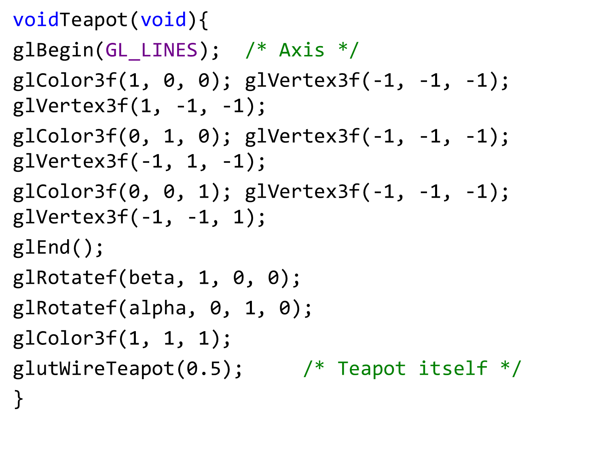

Slide 84
voidDisplayFunc(void)
{
glClear(GL_COLOR_BUFFER_BIT);
glLoadIdentity();
glViewport(0, 0, width / 2, height / 2); /* Perspective view */
glPushMatrix();
glTranslatef(0, 0, -10);
glRotatef(rotate_y, 1, 0, 0);
glRotatef(rotate_x, 0, 1, 0);
Teapot();
glPopMatrix();

Slide 85
glMatrixMode(GL_PROJECTION); /* Orthogonal projection */
/** Note how the projection matrix is pushed, to save the perspective
** computed in ReshapeFunc*/
glPushMatrix();
glLoadIdentity();
if (height > width)
glOrtho(-1.2, 1.2, -1.2 * hw, 1.2 * hw, -1.2, 1.2);
else
glOrtho(-1.2 * wh, 1.2 * wh, -1.2, 1.2, -1.2, 1.2);
glMatrixMode(GL_MODELVIEW);
glViewport(0, height / 2 + 1, width / 2 + 1, height / 2); /* Right view */
glPushMatrix();
glRotatef(90, 0, -1, 0);
Teapot();
glPopMatrix();

Slide 86
/* Face view */
glViewport(width / 2 + 1, height / 2 + 1, width / 2, height / 2);
glPushMatrix();
Teapot();
glPopMatrix();
glViewport(width / 2 + 1, 0, width / 2, height / 2); /* Top view */
glPushMatrix();
glRotatef(90, 1, 0, 0);
Teapot();
glPopMatrix();
glMatrixMode(GL_PROJECTION); /* Projection matrix is restaured */
glPopMatrix();
glMatrixMode(GL_MODELVIEW);
glFlush(); /* End */
glutSwapBuffers(); }

Slide 87
voidReshapeFunc(int new_width, int new_height)
{
width = new_width;
height = new_height;
hw = height / (float)width;
wh = width / (float)height;
glMatrixMode(GL_PROJECTION);
glLoadIdentity();
gluPerspective(20 * sqrtf(1 + hw * hw), wh, 8, 12);
glMatrixMode(GL_MODELVIEW);
glutPostRedisplay();
}

Slide 88
voidKeyboardFunc(unsigned char key, int x, int y)
{
xold = x; /* Has no effect: just to avoid a warning */
yold = y;
if ('q' == key || 'Q' == key || 27 == key)
exit(0);
}

Slide 89
voidMouseFunc(int button, int state, int x, int y)
{
if (GLUT_LEFT_BUTTON == button)
left_click = state;
if (GLUT_RIGHT_BUTTON == button)
right_click = state;
xold = x;
yold = y;
}

Slide 90
voidMotionFunc(int x, int y)
{
if (GLUT_DOWN == left_click)
{
rotate_y = rotate_y + (y - yold) / 5.f;
rotate_x = rotate_x + (x - xold) / 5.f;
if (rotate_y > 90)
rotate_y = 90;
if (rotate_y < -90)
rotate_y = -90;
glutPostRedisplay();
}

Slide 91
if (GLUT_DOWN == right_click)
{
beta = beta + (y - yold) / 2.f;
alpha = alpha + (x - xold) / 2.f;
glutPostRedisplay();
}
xold = x;
yold = y;
}

Slide 92
intmain(int argc, char **argv) {
glutInit(&argc, argv);
glutInitDisplayMode(GLUT_RGB | GLUT_DOUBLE);
glutInitWindowSize(500, 500);
glutCreateWindow("Viewport");
glClearColor(0, 0, 0, 0);
glEnable(GL_CULL_FACE);
glCullFace(GL_BACK);
glEnable(GL_BLEND);
glBlendFunc(GL_SRC_ALPHA, GL_ONE_MINUS_SRC_ALPHA);
glutDisplayFunc(&DisplayFunc);
glutReshapeFunc(&ReshapeFunc);
glutKeyboardFunc(&KeyboardFunc);
glutMouseFunc(&MouseFunc);
glutMotionFunc(&MotionFunc);
glutMainLoop();
return 0;
}

Slide 94
Odev 2
Yatay, arka, zemin ve yan duvarları olan (üst=çatı yok) bir oda çizin. Bu oda zemini herhangi bir şekil olabilir: dikdörtgen, üçgen, daire, beşgen….
Farklı renkler kullanın duvarlar için.
Odanın içine güneş sistemini, bir önceki ödevde yaptığınız, yerleştirin
Gezegenler (en az 2) otamatik dönsün
Gezegen ekleyip çıkarabilelim.

Slide 95
Quiz:
Ekranı kesikli çizgiler ile dört parçaya ayırıp her bir alana bir geometrik şekil çiziniz ve onları klavye/fare ile döndürünüz/öteleyiniz/küçültüp-büyültünüz:
OkulNo tek ise: üçgen, sphare, cube, kısa çizgi
OkulNo çift ise: kare, Torus, cone, büyük nokta
OkulNo son rakam asal ise: klavye
OkulNo son rakam asal ise: fare
kullanın
Cam kenarında oturanlar sağa ve sola döndürsün
Koridorda olanlar küçültsün ve büyültsün
notlara bakabilirsiniz, saat 12.00 da sisteme isim, exe ve kaynak kodu yüklenmiş olsun

